Slide 1
Two Lectures
Language Based Security

Slide 2
Flow-Secure Access Controls
Integration of Simple flow controls into the access control mechanisms of say operating systems.
General:
p can read from x1,. . . , xm and write into
Y1, . . . . Yn only if
This automatically guarantees the security of all flows, explicit or implicit, internal to the process.

Slide 3
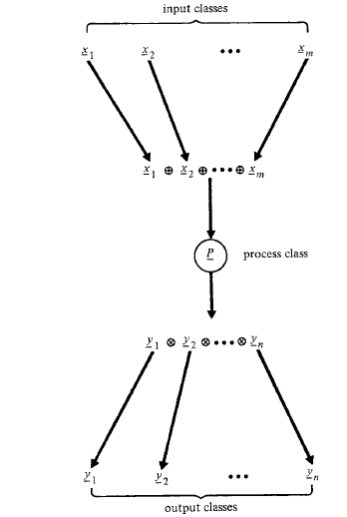

Slide 4
Military Systems
Access controls enforce both a nondiscretionary policy of information flow based on the military classification scheme(MLS), and
a discretionary policy of access control based on "need-to-know“ (that is, on the principle of least privilege).
A process running with a Secret clearance, for example, is permitted to read only from Unclassified, Confidential, and Secret objects;
and to write only tO Secret and Top Secret objects subject to integrity constraints of writing into Top Secret objects.

Slide 5
Dynamically determining Determining Labels
OS (ADEPT) :
the security clearance p of a process p, called its "high water mark", is dynamically determined by the least upper bound of the classes of all files opened for read or write operations;
thus p is monotonically nondecreasing.
When the process closes a newly created file f, the class f is set to p.
Privacy: Privacy Restriction Processor is similar, except that p is determined by lub the of the classes opened for read, and
whenever the process writes into a file f, the file's class is changed to f = f lub p

Slide 6
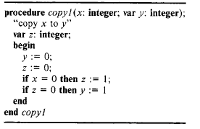
Problem of Dynamic determinations
Suppose the procedure copy1 is split between processes p1 and p2, where p1 and p2 communicate through a global variable z dynamically bound to its security class:
p1:: if x=O then z:= 1
p2: if z=O then y:= 1 .

Slide 7
P1 and P2 are are set to the lub of the classes of all objects opened
for read or write operations,
y and z are initially 0 and in class Low,
z is changed only when z is opened for writing, and flows to y are verified only
when y is opened for writing.
When x = 0, p1 terminates with z = 1 and z = p1 = x;
thus, p2 is set to x .
But the test "z = 0" in p2 fails, so y is never opened for writing, and the relation p2 < y is never verified.
When x= 1, p1 terminates with p1 = x;
however, because z is never opened for writing, (z, z) = x remains (0, Low);
thus, p2 = Low, y becomes 1, and the relation Low <= y is verified.
In both cases, p2 terminates with y = x, even though the relation x <= y is never verified.
Thus, a leak occurs if x !<= y.

Slide 8
problem does not arise when objects and processes have fixed
security classes.
suppose p1 runs in the minimal class needed to read x;
Then pl will never be allowed to write into z unless x
Similarly, p2 will not be allowed to read z unless z
and it will never be allowed to write into y unless
Hence, no information can flow from x to y unless
Because of the problems caused by variable classes, most access-control based
mechanisms bind objects and processes to fixed security classes.
The class of a process p is determined when p is initiated.

Slide 9
Flow Secure Access
Flow-secure access controls provide a simple and efficient mechanism for enforcing information flow within user processes.
But they are limited, because they do not distinguish different classes of information within a process.
For example, if a process, p, reads both confidential (High) and nonconfidential (Low) data, then p must be High, and any objects written by p must be in class High.
The process cannot be given write access to objects in class Low, because there would be no way of knowing whether the information transferred to these objects was confidential or nonconfidential.
The process cannot, therefore, transfer information derived only from the nonconfidential inputs to objects in class Low.
To enforce security within processes that handle different classes of information, the information flow internal to a process must be examined.

Slide 10

Flow Specifications
Let u denote an input parameter x or input/output parameter y, and let v denote either
a parameter or local variable.
The declaration of v has the form v: type class { u | u → v is allowed}
The class of an input/output parameter y will be of the form (y, u1, … uk)
where u1 . . . . , u k are other inputs to y.
If y is an output only, the class of y will be of the form (u1, . . . , u k) (i.e., y not in y);
hence, its value must be cleared on entry to the procedure to ensure its old value
cannot flow into the procedure.
References to global variables are not permitted;

Slide 11
Flow Specifications
The class declarations are used to form a subset lattice of allowable input/output relations
Specifying the security classes of the parameters and local variables as a subset lattice simplifies verification.
Because each object has a fixed security class during program verification, the problems caused by variable classes are avoided.
At the same time, the procedure is not restricted to parameters having specific security classes; the classes of the actual parameters need only satisfy the relations defined for the formal parameters.
We could instead declare specific security classes for the objects of a program;

Slide 12
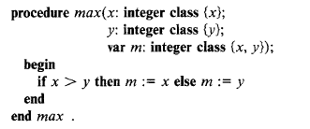
Flow Specifications: Simple Certification
Specify the flow (assuming no global variables)
Security Class implied: x <= m and m >= y

Slide 13
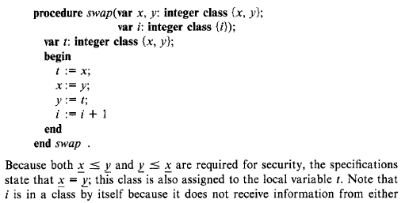
x or y

Slide 14
Security Requirements
A procedure is secure if it satisfies its specifications; that is, for each input u and output y, execution of the procedure can cause a flow u → y only if the classes specified for u and y satisfy the relation u <= y.

Slide 15
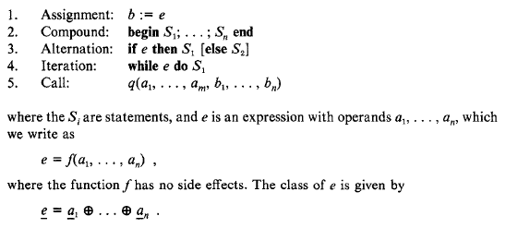
Sufficient conditions for security

Slide 16
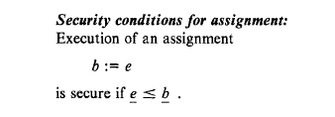
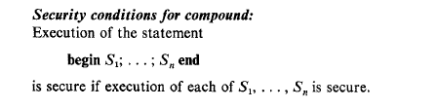

Slide 17
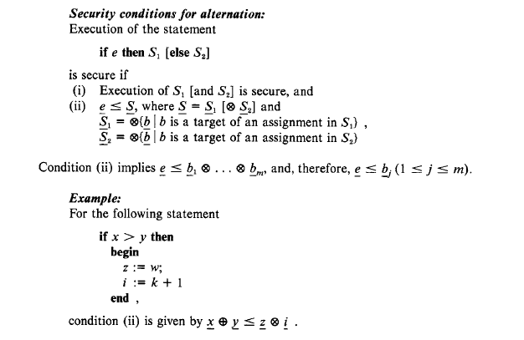

Slide 18
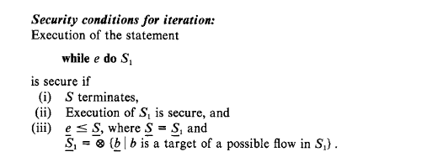

Slide 19
Nonterminating loops can cause additional implicit flows, because execution of the remaining statements is conditioned on the loop terminating
Even terminating loops can cause covert flows, because the execution time of a procedure depends on the number of iterations performed.
No Good Solution

Slide 20
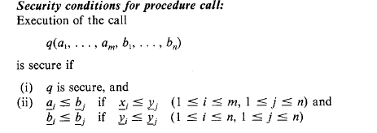
If q is a main program, the arguments correspond to actual system objects.
The system must ensure the classes of these objects satisfy the flow requirements
before executing the program.
This is easily done if the certification mechanism stores the flow requirements of the
parameters with the object code of the program.

Slide 21


Slide 22
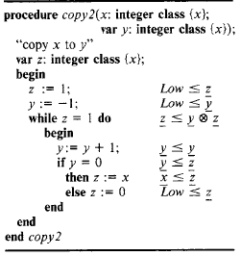

Slide 23
The flow x → y is indirect:
an explicit flow x →z occurs during the first iteration;
this is followed by an implicit flow z → y during the second iteration due to the iteration being conditioned on z.

Slide 24
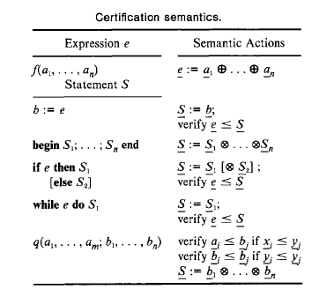
Certification Semantics

Slide 25
Certifications Semantics (2)
The certification mechanism is sufficiently simple that it can be easily integrated into the analysis phase of a compiler.
As an expression e = f ( a 1 , . . . , an) is parsed, the class e = a1 lub ... lub an computed and associated with the expression.
This facilitates verification of explicit and implicit flows from a1 . . . . . an.

Slide 26
Certifications Semantics (3)
Example:
Expression e = "a + b*c" is parsed,
the classes of the variables are associated with the nodes of the syntax tree and propagated up the tree, giving e = a lub b lub c
if a = b then
begin
c := 0;
d:=d+1
end
Else d := c * e

Slide 27
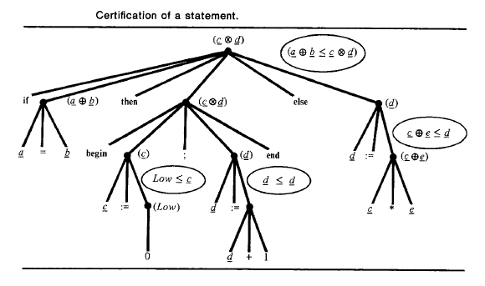

Slide 28
Array Statement (1)
Example:
b := a[e].
If e is known but a[e] is not, then execution of this statement causes a flow
a[e] → b.
If a[i] is known for i = 1 . . . . , n but e is not, it can cause a flow e → b
(e.g., if a[i] = i for i = 1, . . . . n, then b = e).

Slide 29
Array Statement (2)
an assignment of the form "a[e] := b" can cause information about e to flow into a[e].
Example:
If an assignment "a[e] := 1" is made on an all-zero array, the value of e can be obtained from the index of the only nonzero element in a.

Slide 30
Array Statement (3)
If all elements a[i] belong to the same class a, the certification mechanism is easily extended to verify flows to and from arrays.
For an array reference "a[e]", the class a lub e can be associated with the reference to verify flows from a and e.
For an array assignment "a[e] := b", the relation e < a can be verified along with the relation b < a.
If the elements belong to different classes, it is necessary to check only the classes a[i] for those i in the range of e.
This is because there can be no flow to or from a[j] if e never evaluates to j (there must be a possibility of accessing an object for information to flow).

Slide 31
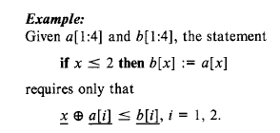
What about?
NEED Further Analysis
As a general rule, a mechanism is needed to ensure addresses refer to the
objects assumed during certification.
Otherwise, a "a[e] := b“ might cause an invalid flow b →c, where c is an object
addressed by a[e] when e is out of range.
Several possible approaches
check the bounds of array subscripts and pointer variables.
A more efficient method is possible if each array object in memory has a descriptor
giving its bounds; the hardware can then check the validity of addresses in parallel with
instruction execution.
3rd method is to prove that all subscripts and pointer variables are within their bounds;

Slide 32
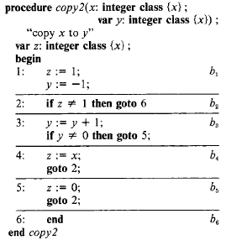
Control Structures with Unrestricted Goto’s
Certifying a program with unrestricted gotos, requires a control flow analysis of the
program to determine the objects receiving implicit flows.

Slide 33
A control flow graph is constructed, showing transitions among basic blocks;
associated with block bi is an expres., ei that selects the successor of bi in the graph
The security class of block bi is the glb of the classes
of all objects that are the targets of flows in bi (if there are no such objects, this class is High).
The immediate forward dominator IFD(bi) is computed for each block bi
It is the closest block to bi among the set of blocks that lie on all paths from bi to the program exit and, therefore, is the point where the divergent execution paths conditioned on ei converge.
Define Bi as the set of blocks on some path from bi to IFD(bi) excluding bi and IFD(bi).
The security class of Bi is Bi = glb {bj | bj in Bi}

Slide 34
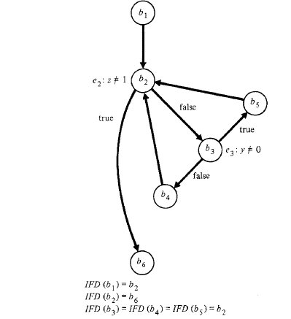

Slide 35
Because the only blocks directly conditioned on the selector expression ei of bi are those in Bi, the program is secure if each block bi is independently secure and ei < Bi for all i.

Slide 36
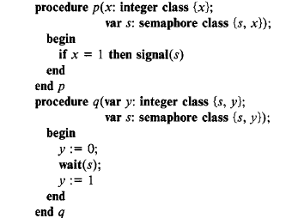
Concurrency and Synchronization

Slide 37
Concurrent execution of these procedures causes an implicit flow of information from parameter
x of p to parameter y of q over the synchronization channel associated with the semaphore s:
if x = 0, y is set to 0, and q is delayed indefinitely on s;
If x = 1, q is signaled, and y is set to 1.
Thus, if p and q are invoked concurrently as follows:
cobegin
p(a, s)
||
q(b, s)
coend
the value of argument a flows into argument b.

Slide 38
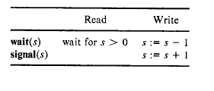
The flow x → y in is caused by wait(s) and signal(s),
which read and modify the value of s as follows
Therefore, execution of the if statement in p causes an implicit flow from x to s,
causing the value of x to flow into q.
When x = 0, q is left waiting on semaphore s.
Because this is similar to a nonterminating while loop, we might wonder if all
synchronization channels are associated with abnormal terminations from timeouts.
If so, they would have a channel capacity of at most 1 bit
However, that information can flow along synchronization channels even when the
procedures terminate normally

Slide 39
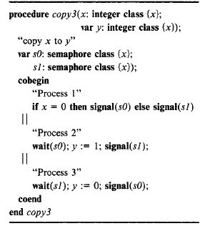
When x = 0, process 2 executes before process 3, so the final value of y is 0;
when x != 0, process 3 executes before process 2, so the final value of y is 1.
Hence, if x is initially 0 or 1, execution of copy3 sets y to the value of x.

Slide 40
Because each statement logically following a wait(s) operation is conditioned on a signal(s) operation, there is an implicit flow from s to every variable that is
the target of an assignment in a statement logically following the wait.
To ensure the security of these flows, we require the class of every such variable y satisfy the relation
s < y .

Slide 41
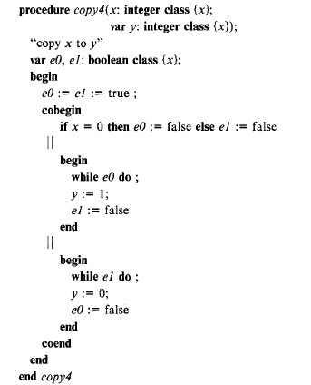
Concurrency: flow over Global channels
We require e0 < y
and e1 < y
e0 and e1 playing the role of semaphores s0 and s1
A signaling process can covertly leak
a value by making the length of delay
proportional to the loop.
Similar problem of loops

Slide 42
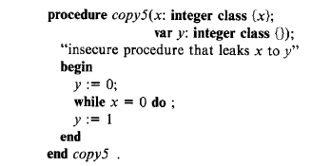
Abnormal terminations
If x = 0, then y becomes 0, and the procedure hangs in the loop; if x = 1,
then y becomes 1, and the procedure terminates.
x→ y , as y:=1 is conditioned on x. Thus there is a flow even though that is not the
target
Such covert channels are not necessarily confined to nonterminating loops.

Slide 43
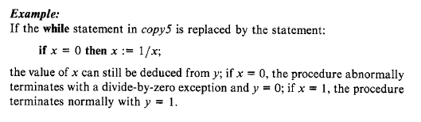
Indeed, the nonterminating while statement could be replaced by any action that
causes abnormal program termination:
end-of-file, subscript-out-of-range, etc.
Furthermore, the leak occurs even without the assignments to y, because the value
of x can be determined by whether the procedure terminates normally.

Slide 44
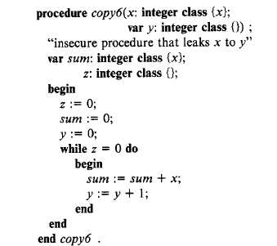
The problem of abnormal termination
can be handled by inhibiting all traps
except those for which actions have
been explicitly defined in the program
loops until the variable sum overflows;
the procedure then terminates, and x can be approximated by MAX/y,
where MAX is the largest possible integer.
The program trap causes an implicit flow x → y because execution of the assignment to y
is conditioned on the value of sum, and thus x, but we do not require that x < y.

Slide 45
Adding a condition statement
Example: If the statement
on overflow sum do z "= 1
were added to the copy6 procedure, the security check sum < z would be made, and the procedure would be declared insecure

